Slide 1
Predicting Obesity Levels
Jacob Korte, Fabian Gutierrez, Anthony Montano, Alex Camilleri

Slide 2
Questions
How does picking the right k value effect k means accuracy?
What is the importance of feature selection for training on data?
What is one of the top 4 features that contributes most to obesity level?

Slide 3

Introduction
Goal: Predicting obesity levels with the use of 16 features
Which features contribute most to a person’s obesity level?
UCI machine learning dataset on obesity
Techniques used: supervised learning(KNN) Unsupervised learning (feature selection, and K means clustering)

Slide 4
Data Set
Data set
Contains obesity levels of people from Peru, Mexico, and Colombia
Obesity levels based off of 16 features
Features include gender, weight, age, if the person smokes, etc

Slide 5
Cleaning the data set
Features that needed to be cleaned:
Obesity Level (Insufficient, Weight, Normal Weight etc.)
Survey Response Scales (ex. No, Sometimes, Always, Frequently)
Mode of Transportation ( Walking, Automobile, Motorbike, Bike )
Eliminating NaN values
Some features in the dataset were categorical and in order to use the data for analysis, features were changed to numerical in the range of 0-n depending on the number of options available.

Slide 6
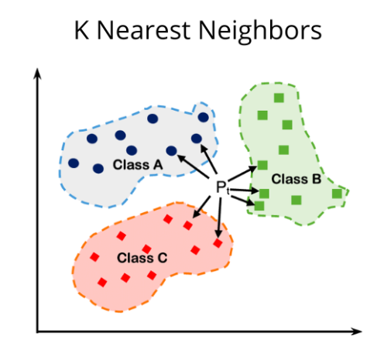
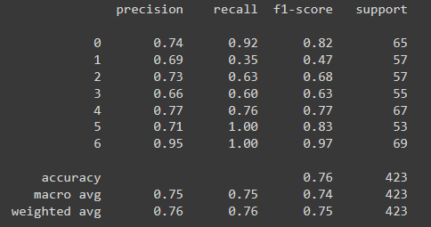
KNN
Supervised learning technique used to classify data points
Clean data to remove string values and change them to numerical values (e.g. yes-1)
Standardize the data set before running KNN
K = 19 (odd #)
Measure performance using classification matrix

Slide 7
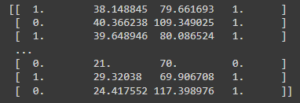
Feature Selection
Unsupervised learning technique
Looks for columns in graph that have most correlation with our key value, obesity
Top 4 = Gender, age, family history with obesity, and weight
Determines which columns are most important to test in other unsupervised methods
K-Means clustering

Slide 8
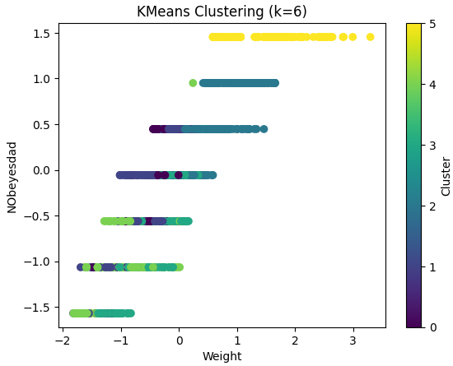
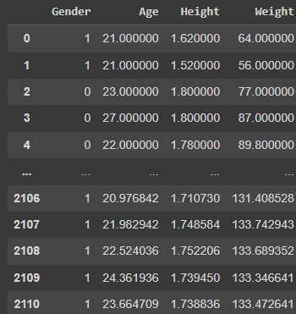

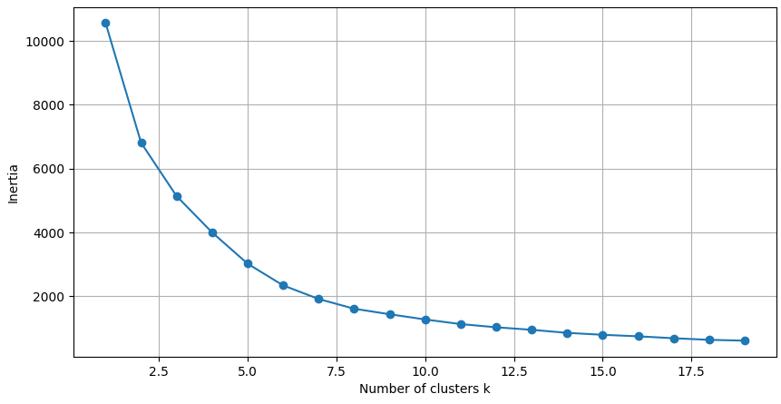
K Means Clustering
Unsupervised testing by grouping data points with similarities in multiple dimensions into clusters
One version for all columns, one version for critical columns determined by feature selection
Utilizes the elbow method for choosing the right k value - at point where inertia slows
Measures of obesity and selected features in 6 clusters together
For Significant Features

Slide 9
EDA

Slide 10
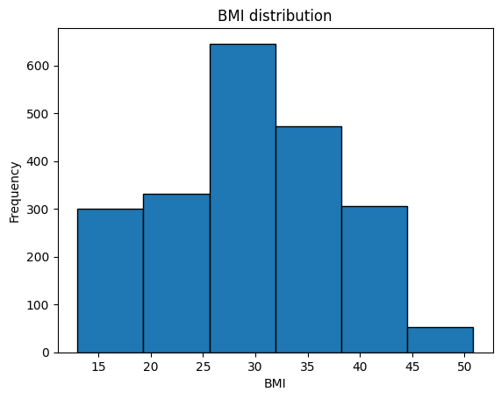
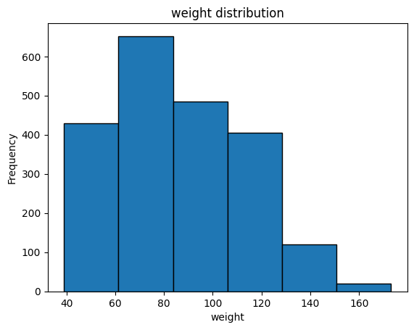
EDA
Most of the test group had an average BMI around 30 to 35, and weighted around 70 to 80 kilograms

Slide 11
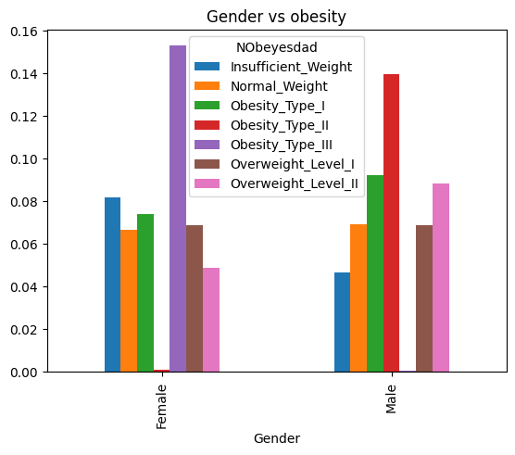
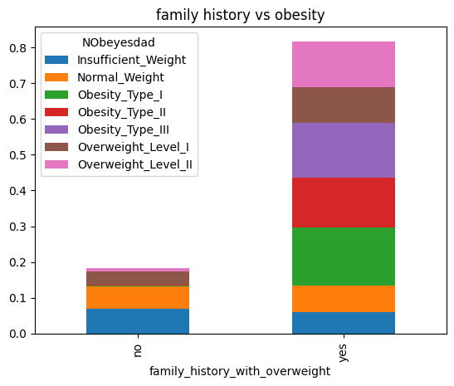
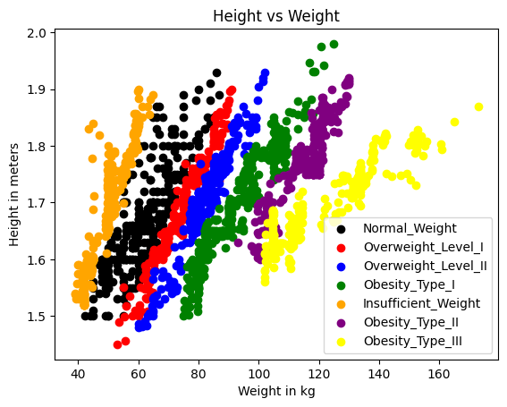
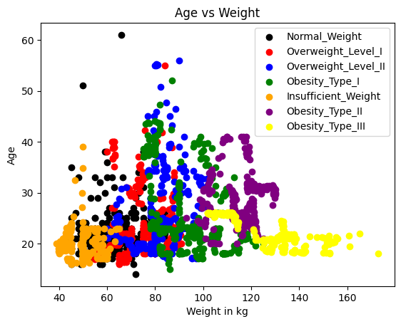
EDA

Slide 12
Conclusion
After our analysis, we were able to predict someone's obesity level based off the 16 features
The features that contributed the most are Gender, age, family history with obesity, and weight
We were surprised to see that other features like whether they smoke or drink alcohol were not included in the top 4 features

Slide 13
Thanks for listening!
References:
https://www.youtube.com/watch?v=iNlZ3IU5Ffw
https://medium.com/@sachinsoni600517/k-nearest-neighbours-introduction-to-machine-learning-algorithms-9dbc9d9fb3b2

